Slide 1
Case Study 1
By: Joshua Samuel

Slide 2
Problem
Frito Lay has hired DDSAnalytics to figure out why employees are leaving the company (attrition).
DDSAnalytics’ goal is to predict which employees might be more likely to leave and to identify the main reasons behind attrition so the company can take the necessary steps to reduce it.

Slide 3
Costs
Replacing an employee who leaves can cost anywhere from 50% to 400% of that employee’s annual salary.
Estimated cost of offering incentives to help retain employees is about $200 per employee.

Slide 4
Summary of attritions
Count
Percent of Total
730
83.91%
No
140
16.09%
Yes
Total
870
100%

Slide 5
Initial Data Wrangling
No NA values were found in the dataset.
Changed “BusinessTravel”, “Department”, and “EducationField” from nominal variables to ordinal per description in Data Dictionary.
Will have to do further wrangling for KNN model due to the requirement of numerical predictors.
Will also remove several variables that we do not believe contribute to prediction.

Slide 6
Visualizations - EDA

Slide 7
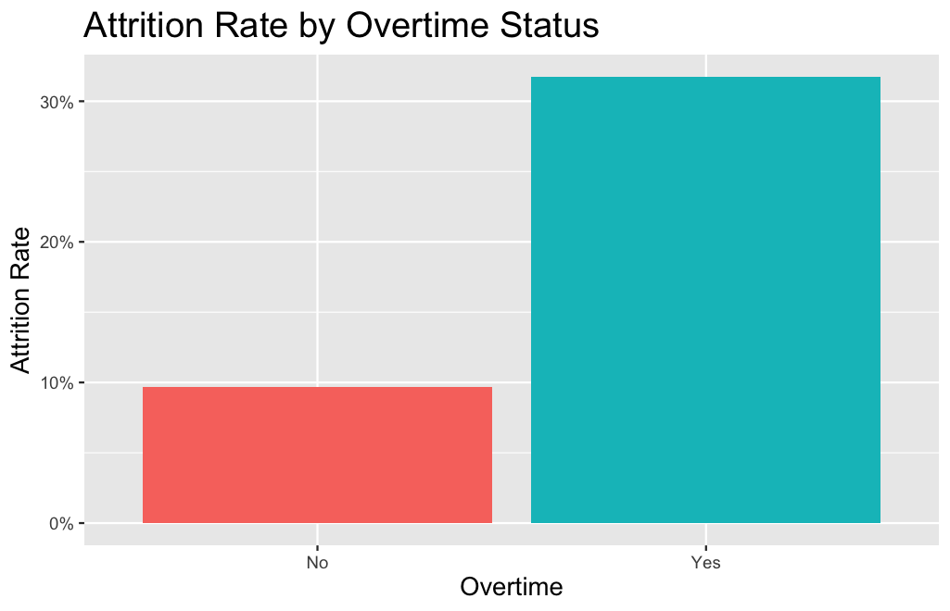
Employees who worked Overtime had an extremely higher attrition rate than those that did not at about 31.7%.

Slide 8
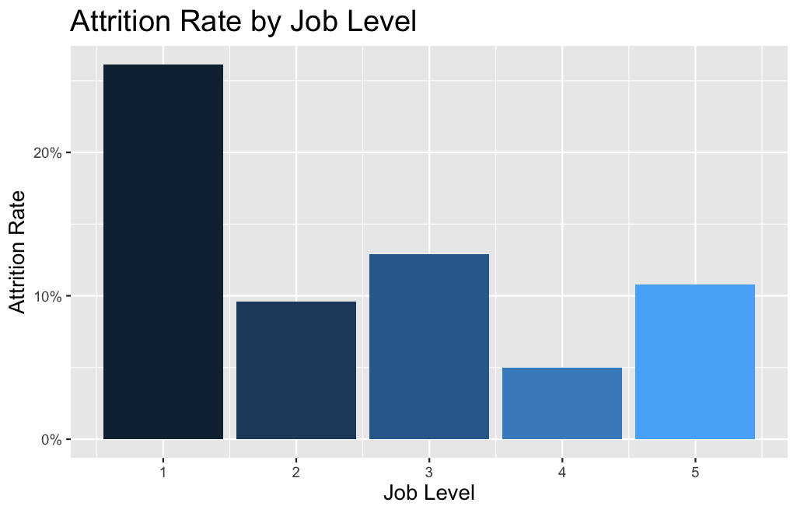
Employees who had a Job Level = 1, had a substantially higher attrition rate than the other Job Levels at about 26.1%

Slide 9
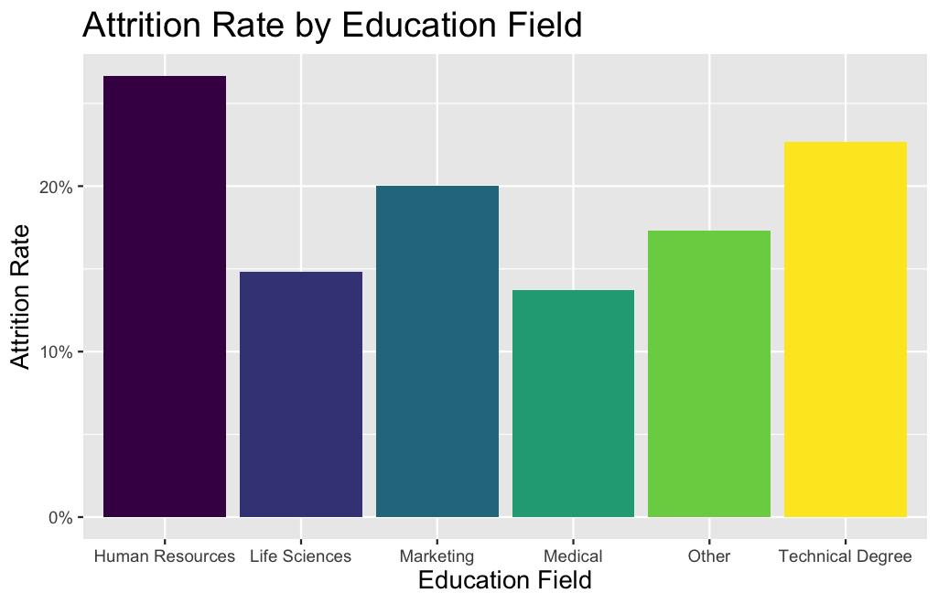
Human Resources appears to have the highest attrition rate among Education Fields at around 26.7%.

Slide 10
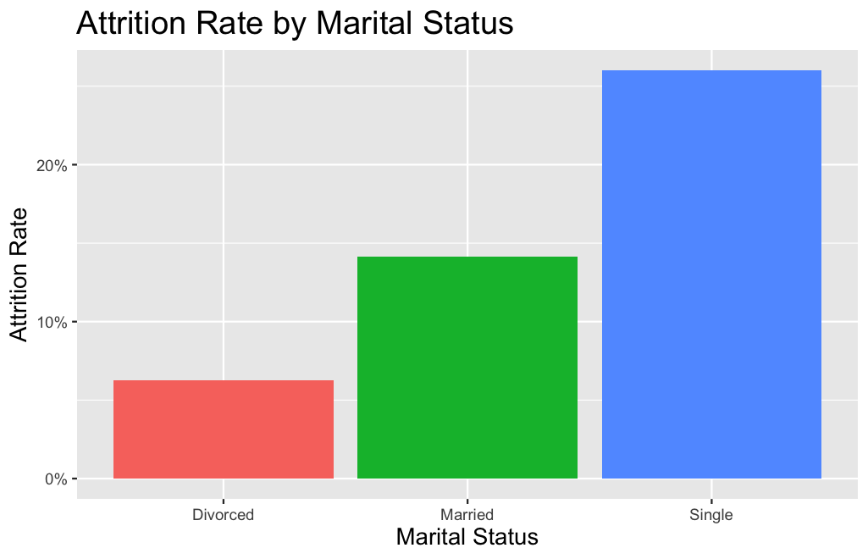
Employees who were single had a much higher attrition rate than those who were divorced or married at about 26%.

Slide 11
MODELING – Naïve Bayes

Slide 12
Naïve Bayes MODEL (cont.)
The predictors for our model: MonthlyIncome, TotalWorkingYears, OverTime, JobLevel, YearsAtCompany, YearsInCurrentRole, NumCompaniesWorked, EducationField, StockOptionLevel, Age, MaritalStatus, Department, JobRole, JobInvolvement, JobSatisfaction.
Used a custom decision threshold of 0.30 for predicting “Yes” instead of traditional 0.50.
Looked at 100 different iterations of train/test splits (70% train / 30% test) and took mean accuracy, sensitivity, and specificity over all iterations.

Slide 13
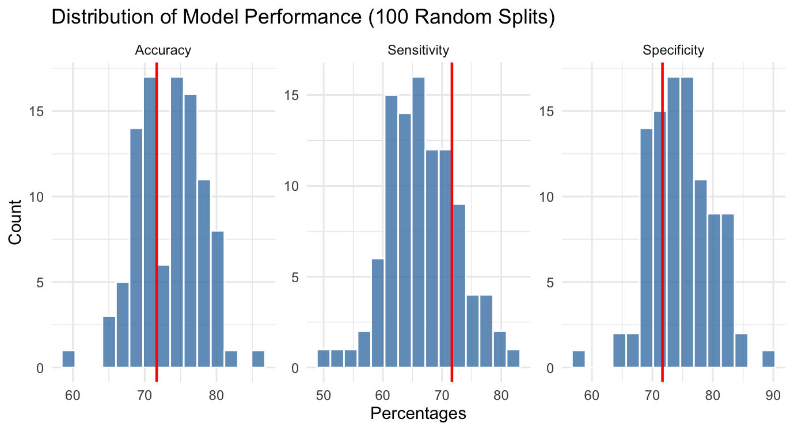
Naïve Bayes MODEL (cont.)
Mean Accuracy: 73.46%
# of correctly classified observations / total # of observations
Mean Sensitivity: 66.75%
# of correctly identified employees who left / true # of employees who left
Mean Specificity: 74.79%
# of correctly identified employees who stayed / true # of employees who stayed

Slide 14
Naïve Bayes MODEL (cont.)
On average, here were our predictions for our test set (261 observations):
164 employees who stayed were correctly predicted to stay
55 employees who stayed were incorrectly predicted to leave
14 employees who left were incorrectly predicted to stay
28 employees who left were correctly predicted to leave
Cost
Average Employee’s Salary for dataset: $76,683
[ (200% of $76,683 ) x 14 ] + [$200 for incentive x 83]
Estimated Total Cost: $2,164,724
Actual
Stay
Leave
164
14
Stay
Predicted
55
28
Leave

Slide 15
MODELING – KNN

Slide 16
KNN MODEL
The predictors for our model (same as NB): MonthlyIncome, TotalWorkingYears, OverTime, JobLevel, YearsAtCompany, YearsInCurrentRole, NumCompaniesWorked, EducationField, StockOptionLevel, Age, MaritalStatus, Department, JobRole, JobInvolvement, JobSatisfaction.
Due to the mathematical computation of the KNN Model, predictors Department, EducationField, OverTime, MaritalStatus, & JobRole had to be converted to numeric.
Assigned k = 4 (k is # of nearest neighbors used to make the prediction)
Tested model’s performance on series of k’s (1-20) and determined lower k is better option.
We used a custom decision threshold of 0.15 for predicting “Yes” instead of traditional 0.50.
Looked at 100 different iterations of train/test splits (70% train / 30% test) and took mean accuracy, sensitivity, and specificity over all iterations.

Slide 17
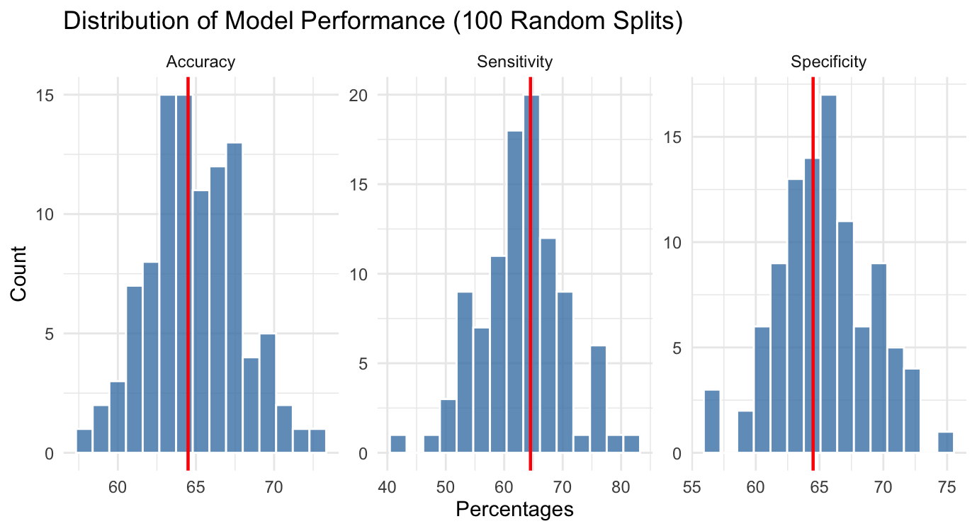
KNN MODEL (cont.)
Mean Accuracy: 64.96%
# of correctly classified observations / total # of observations
Mean Sensitivity: 63.13%
# of correctly identified employees who left / true # of employees who left
Mean Specificity: 65.39%
# of correctly identified employees who stayed / true # of employees who stayed

Slide 18
KNN MODEL (cont.)
On average, here were our predictions for our test set (261 observations):
143 employees who stayed were correctly predicted to stay
76 employees who stayed were incorrectly predicted to leave
16 employees who left were incorrectly predicted to stay
26 employees who left were correctly predicted to leave
Cost
Average Employee’s Salary for dataset: $76,683
[ (200% of $76,683 ) x 16 ] + [$200 for incentive x 102]
Estimated Total Cost: $2,474,256
Cost is $309,532 more than NB Model
Actual
Stay
Leave
143
16
Stay
Predicted
76
26
Leave

Slide 19
Concluding thoughts
On average, it appears that our Naïve Bayes model performed better than our KNN (k = 4) model as it outperformed in accuracy, sensitivity, and specificity.
From an estimated cost standpoint, our Naïve Bayes model also would cost us $309,532 less than if we used our KNN model.

Slide 20

Questions?

Slide 21
Appendix

Slide 22
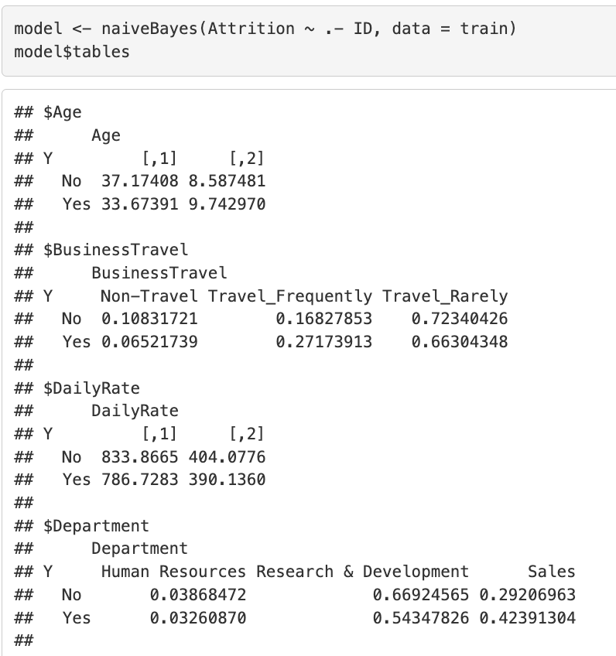
Variable selection methodology
After running a Naïve Bayes model with all predictors included, I used the following R code to see which predictors contribute the most to predicting Attrition.
Note:
For numeric predictors, first column is the mean, and the second column is standard deviation. If there is a large difference between means of Yes v No Group, then it's a very strong predictor.
For categorical predictors, each row represents the conditional probabilities for a specific response (Attrition = Yes vs No) across classes.

